Slide 1
Greening the Hubs
Skills gap analysis

Slide 2
5 key takeaways
Social sustainability is where hubs feel strongest
Core barriers are structural: time, funding, and infrastructure
Digital tools are a blind spot
Many hubs are taking first steps, but lack depth and measurement
Skills exist, but teams are missing, and data skills top the list

Slide 3
Sustainable practices are strongest in infrastructure, weakest in energy and team engagement
Sustainable practices in daily operations
3.4
1
5
To what extent do you feel your hub applies sustainable practices in daily operations?

Slide 4
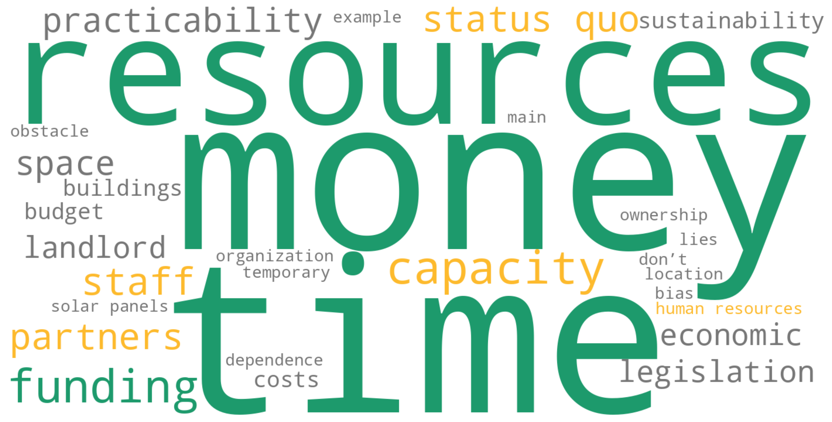
Time, money, and capacity block sustainability
Top-of-mind challenges
The main challenges in implementing sustainability center around limited financial and human resources, lack of time and capacity, and external constraints such as building ownership or partner dependencies. Even when the will is there, the combination of cost, complexity, and systemic inertia often keeps organizations stuck in the status quo.
When you think the challenges that prevent you from implementing sustainability practices in your hub, what is the first word that comes to mind?

Slide 5
Core resources - funding, time, infrastructure, and stakeholder buy-in - are the biggest barriers to sustainability in cultural hubs
Main barriers to sustainability
4.5
4.1
4.1
4.0
3.3
3.3
2.7
2.6
2.4
2.4
2.1
2.1
Below is a list of barriers that operators say prevent them from implementing sustainability practices in their hubs. Please rate each one from 1 (not significant at all) to 5 (extremely significant), with 3 indicating a moderate level of significance.

Slide 6
Digital tools remain largely unused, leaving untapped potential to improve sustainability
Use of digital tools
2.1
1
5
To what extent do you use digital tools for sustainability in your hub?

Slide 7
Cultural hubs report strongest influence on social topics, less on environmental ones
Areas where the Hub has significant impact
4.1
4.1
3.9
3.7
3.7
3.5
3.2
2.8
2.4
The hub I work at has a significant impact on {topic}

Slide 8
Hubs are taking first steps on sustainability, but few measure impact or evaluate KPIs
Readily available data and practices for sustainability
Does your hub have {practice/ data} ?

Slide 9
Most hubs lack a sustainability team, but basic skills are already in place
Sustainability team and skills
3.8
3.4
No
5
5
Yes
1
1
Do you have a dedicated team responsible for sustainability initiatives in your hub? How skilled do you feel this team is in terms of sustainability? How skilled do you feel the entire team of the hub is in terms of sustainability?

Slide 10
Hubs say data, hands-on knowledge, and resource management are key to sustainability success
Skills required for sustainability
Open answers: Common sense regarding economic realities for small businesses, creativity leadership charisma, empathy, logical / accesable space & solutions.
Which skills do you feel are needed for sustainability in your hub?

Slide 11
Demographics
Staff
Regular users
Events per year
Event attendance
Main activities
Funding sources
Open answers: Crowdfunding, loans

